Slide 1
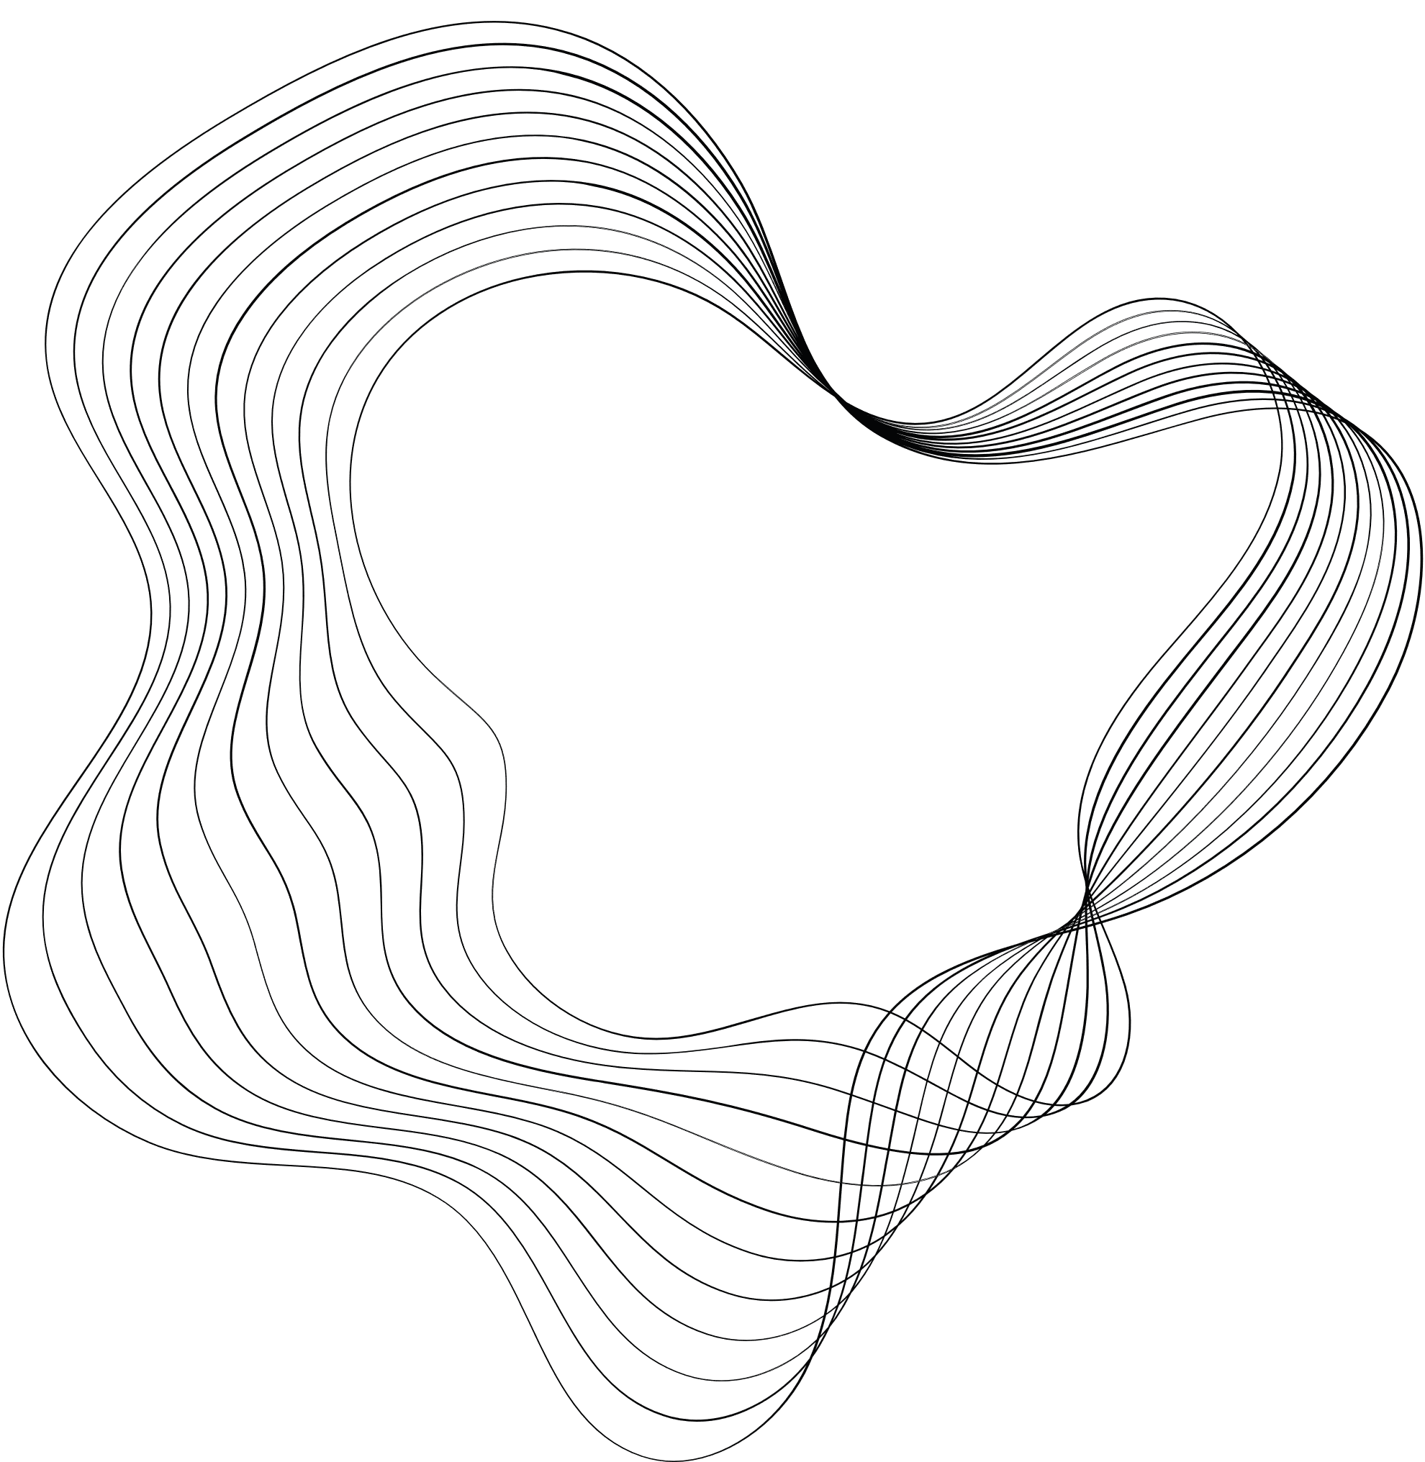

CAREER
CONNECT
INSPIRATIONS
PRAMODYA DHEESHANI ATHAUDA - CB011879

Slide 2

CONTENT
01
XPRESS JOBS
02
ROOSTER JOBS
03
THE MUSE
04
WELLFOUND
05
CURRENT DESIGN PRACTICES
06
REFERENCES

Slide 3
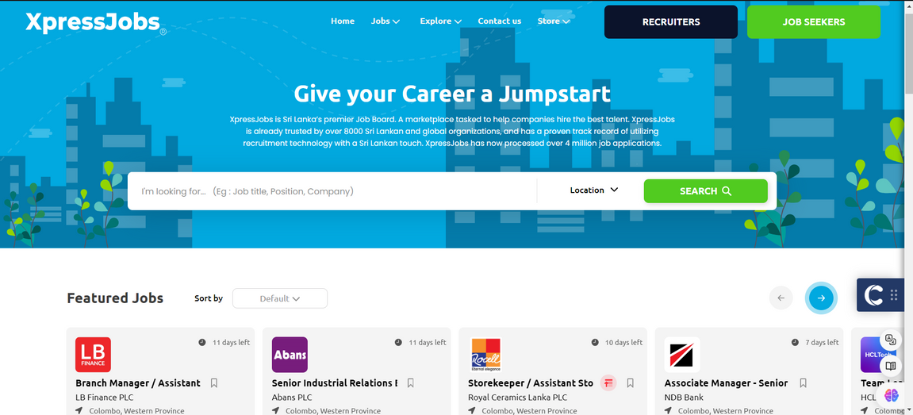
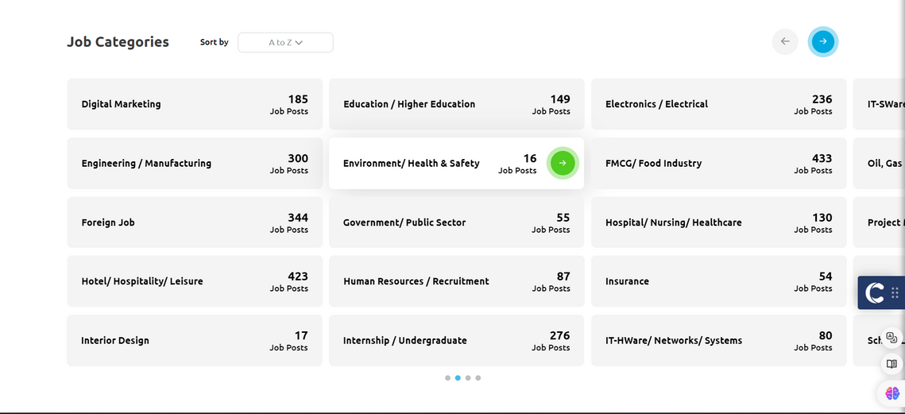

1.XPRESS JOBS
https://xpress.jobs/

Slide 4
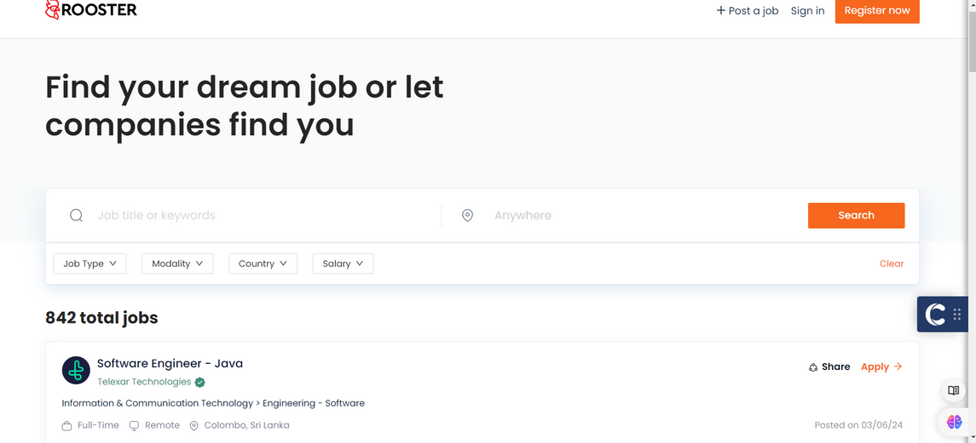
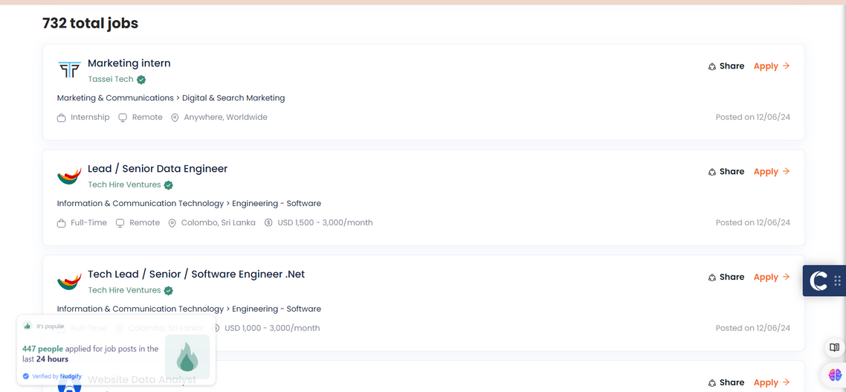
2.ROOSTER JOBS
https://rooster.jobs/

Slide 5
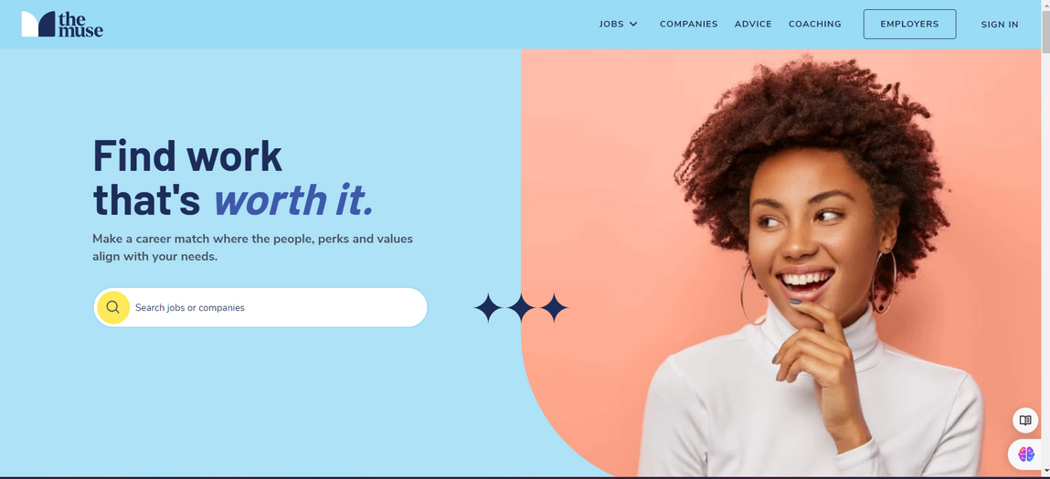
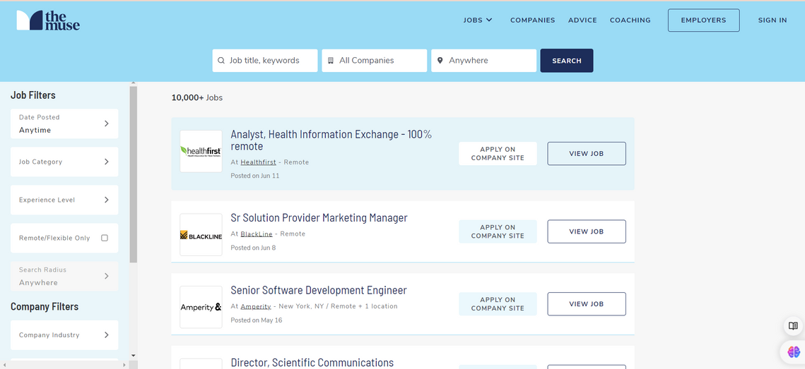
3.THE MUSE
https://www.themuse.com/

Slide 6
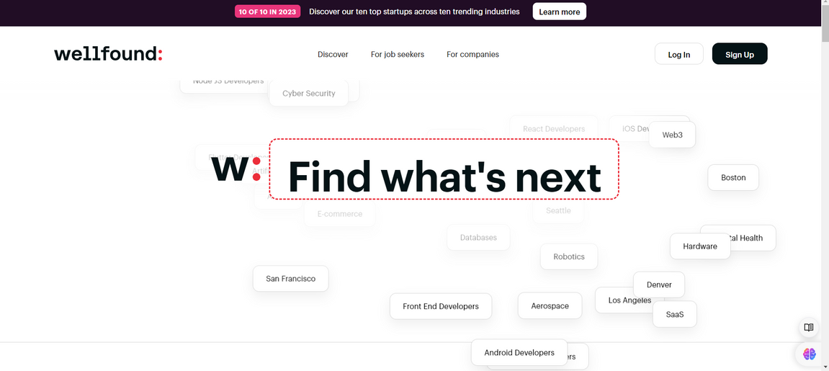
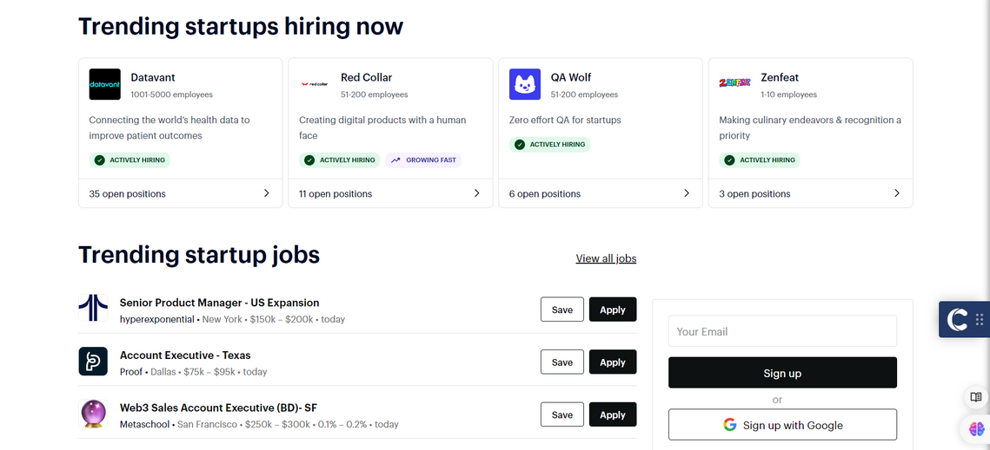
4.WELLFOUND
https://wellfound.com/

Slide 7


CURRENT DESIGN PRACTICES
User-Centric Navigation
Accessibility and Usability
Registration and Onboarding
Intuitive Navigation
Minimalist Design
Accessible Design
Responsive for Desktop and Tablet
Simple registration process
Guided onboarding
Job Posting and Application Features
Search and Filter Options
User Profiles
Detailed job postings
Easy application process
Advanced search functionality
Job alerts
Profile customization
Resue upload and management

Slide 8

REFERENCES
Interaction Design Foundation. (2024). What is Usability - The Ultimate Guide. Available at: https://www.interaction-design.org/literature/topics/usability [Accessed 4 Jun. 2024].
FreeCodeCamp. (2023). Web Accessibility Best Practices – How to Ensure Everyone Can Use Your Website. Available at: https://www.freecodecamp.org/news/web-accessibility-best-practices/ [Accessed 4 Jun. 2024].
Nielsen, J. (2012). Usability 101: Introduction to Usability. Nielsen Norman Group. Available at: https://www.nngroup.com/articles/usability-101-introduction-to-usability/ [Accessed 4 Jun. 2024].

Slide 9
THANKYOU!

